Slide 1

TSP Banking System
Project Presentation
Krishna — Team Lead
Silkcon
Shashank
Jaswanth

Slide 2
Contents
Introduction
Problem Statement
Objectives
System Features
Technologies Used
System Architecture
Database Design
Security Features
Workflow Diagram
Advantages
Future Enhancements
Conclusion

Slide 3


Introduction
Overview of Banking Systems
Importance of Digital Banking
Need for Secure and Scalable Banking Software

Slide 4

Problem Statement
Inefficiencies in traditional banking
Limited accessibility
Declining customer satisfaction
Need for secure online transaction systems

Slide 5
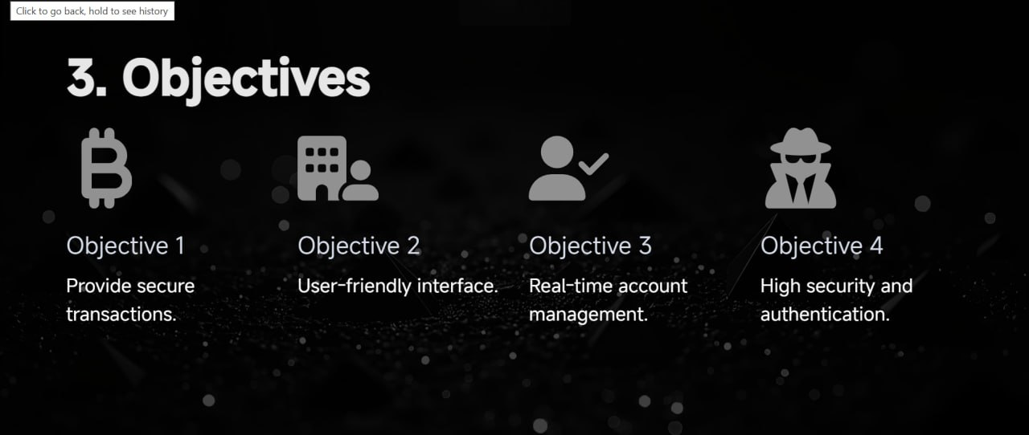

Slide 6
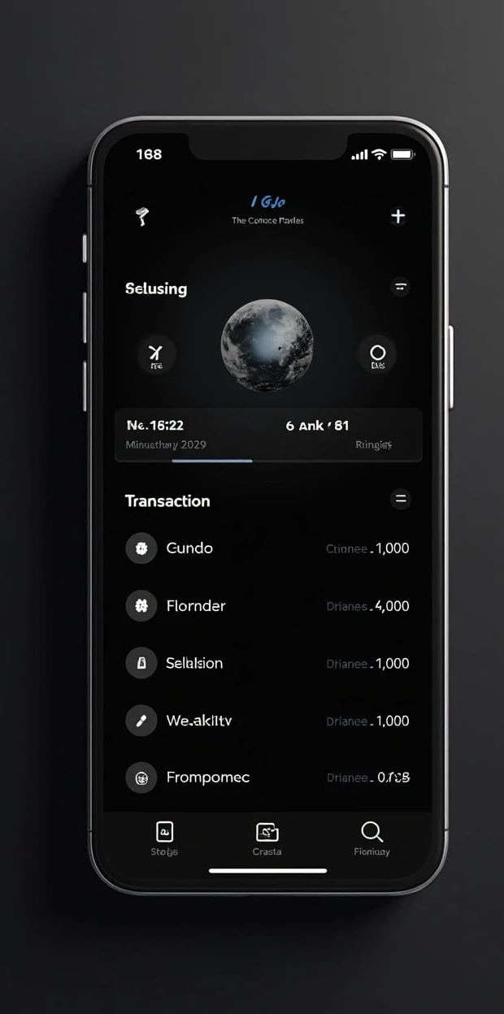
System Features
Account Creation
Login Authentication
Deposit & Withdraw
Fund Transfer
Transaction History
Admin Panel
Customer Dashboard

Slide 7

Technologies Used
Frontend: HTML / CSS / React
Backend: Java / Python / Node
Database: MySQL / MongoDB
Security: Encryption / Authentication

Slide 8

System Architecture
Client-Server Model
Application Layer
Database Layer

Slide 9
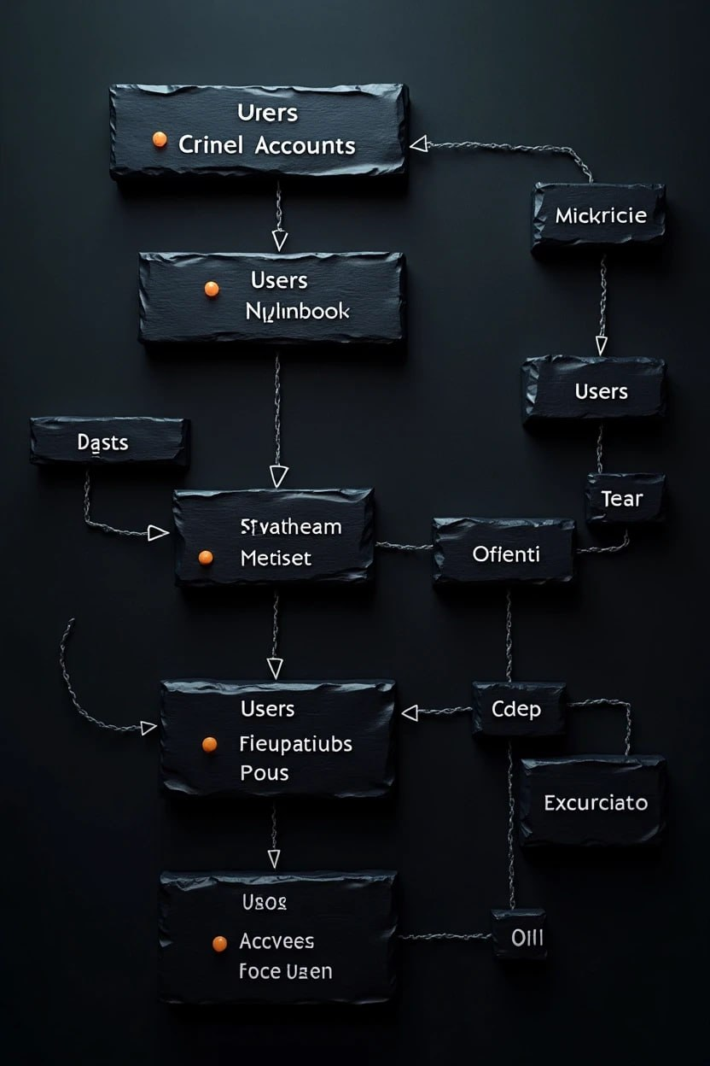
Database Design
Tables: Users, Accounts, Transactions
Primary & Foreign Key Relationships

Slide 10

Security Features
Password Encryption
OTP Verification
Role-based Access
Secure APIs

Slide 11

Workflow Diagram
User Login → Dashboard → Transaction → Database Update

Slide 12

Advantages
Fast transaction processing
Strong security
Scalable design
User-friendly navigation

Slide 13

Future Enhancements
Mobile App
AI-based Fraud Detection
Loan Management Integration
Chatbot Support

Slide 14

Conclusion
Secure and scalable banking solution
Improves digital banking experience

Slide 15

Thank You

